Slide 1
Data processing

Slide 2
Batch Processing
Real Time Processing
Batch Vs Real time processing

Slide 3
Every now and then, almost in every corner of the world….. This happens..!!
Hey Bob..! Why everybody prefers
buying products online?
Tina…! Bcz.. They get so many deals
and many products are available
in different categories.
Well !.. And also they get
recommendations based
on their purchasing behavior and
product reviews…
3
Notes:
Copyright © 2016 Accenture. All rights reserved.

Slide 4
Every now and then, almost in every corner of the world….. This happens..!!
Team...! We need to implement the following features in upcoming Great Indian Sale.
Dynamic pricing based on customers purchasing behaviour.
Product recommendations based on customers purchasing activity.
3
Notes:
Copyright © 2016 Accenture. All rights reserved.

Slide 5
At the same time…. In an eCommerce application development & analytics team
Then.. We need to find an
alternative processing methodology
Yes.. We need to do the processing in real time rather storing the data and then process after some time
I understand.. Then our application
should be very faster & dynamic to
decide deals and prices based
on streaming data
Notes:
Copyright © 2016 Accenture. All rights reserved.

Slide 6
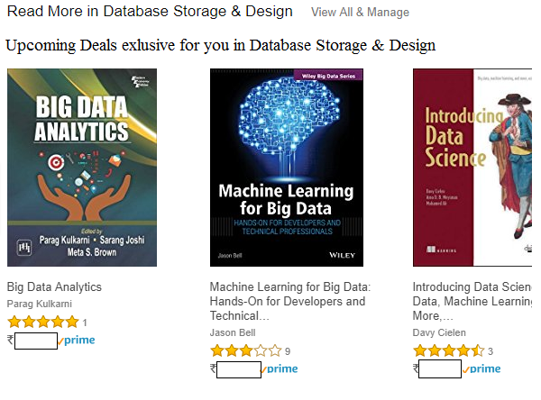


Looking at the scenario, what is required?
From Shopping website
Login ID : C003, Location : Bangalore
Search Page: Data Analytics books
Time: 16:23:45.34, device : mobile
IP: 10.0.12,13 …………
1
Application to decide the
price of books based on
customer logs and
previous search activities
Update price in webpages
2
Big Data Analytics : 566 (15 % off)
Machine Learning for Big Data : 449 (43% off)
Introduction to data science : 687 (12% off)
3
Previous activity logs of customer
C003 stored in HDFS or
Local FS or any other storage

Slide 7

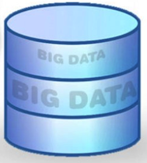

What we have done so far ?
Login ID : C003, Location : Bangalore
Search Page: Data Analytics books
Time: 16:23:45.34, device : mobile
IP: 10.0.12.13 …………………………
Logs
and
customer activity
Login ID : C007, Location : Hyderabad
Search Page: Electronics
Time: 19:23:45.34, device : desktop
IP: 10.0.10.3 …………………………
Local FS or HDFS or any cloud storage
BATCH PROCESSING
MAP REDUCE PROGRAMS

Slide 8
What we need to do?
Login ID : C003, Location : Bangalore
Search Page: Data Analytics books
Time: 16:23:45.34, device : mobile
IP: 10.0.12.13 …………………………
Logs
and
customer activity
Login ID : C007, Location : Hyderabad
Search Page: Electronics
Time: 19:23:45.34, device : desktop
IP: 10.0.10.3 …………………………
Local FS or HDFS or any cloud storage
Faster Processing
Real Time
PROCESSING

Slide 9
Here we have…
APACHE SPARK
The Framework for
Faster Batch & Real Time Data Processing

Slide 10
Questions
Notes:
Application Delivery Fundamentals (ADF) 2.0: Testing
Module 02: Introduction to Software Development Life Cycle (SDLC)

Slide 11
Thank You

